Slide 1

Restaurant Management Systems
___________________________________________
Create a Restaurant Management Systems
Mr. Phattaraphon Chomchaiyaphum
5930300585

Slide 2



Object
Technology
System
Simply

Slide 3
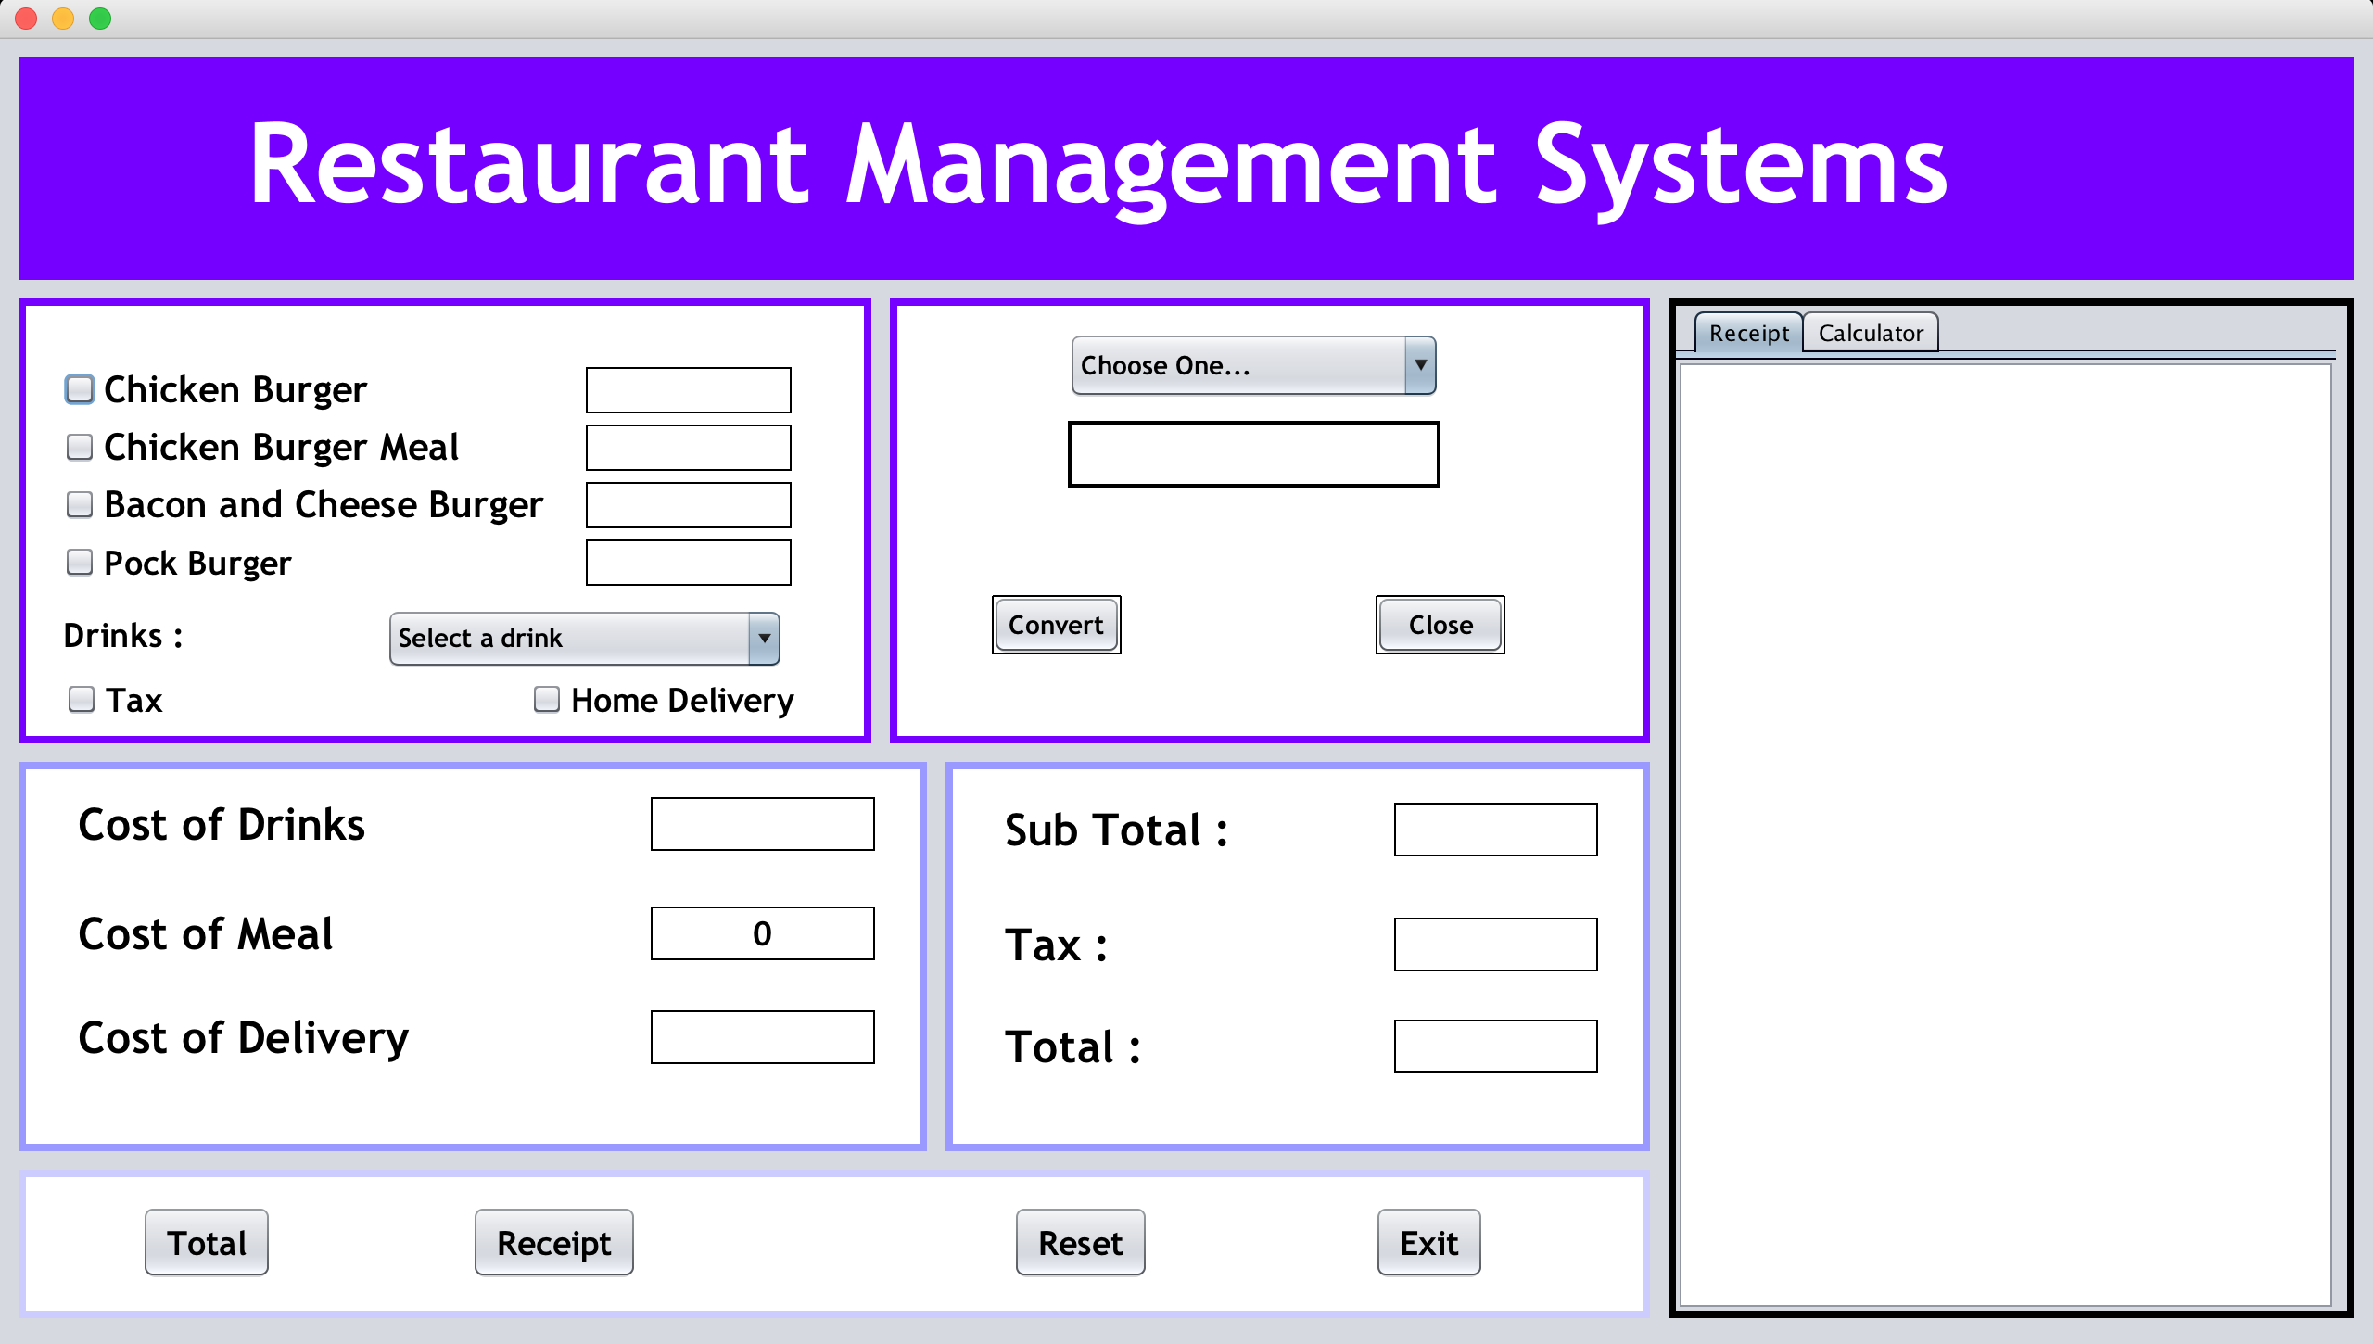
View

Slide 4
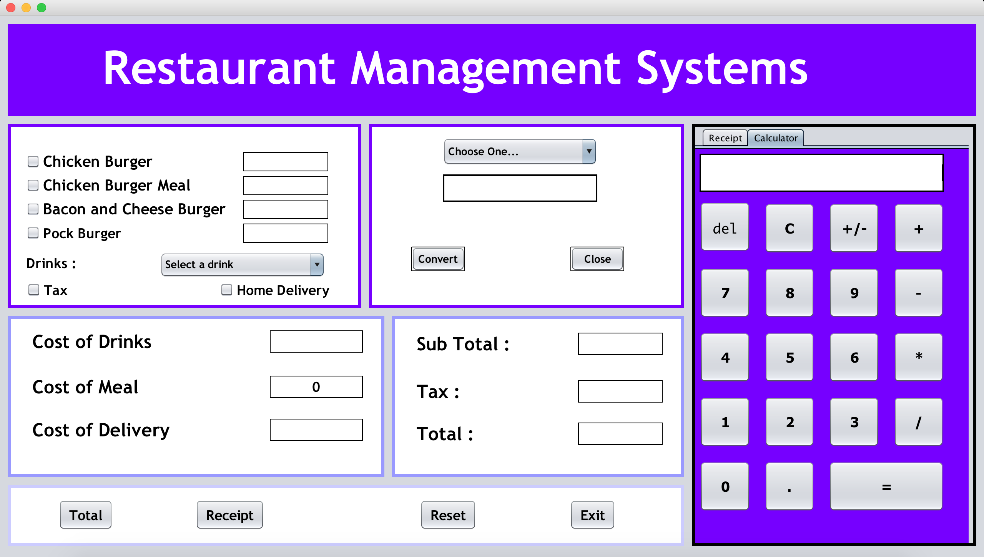
Function
7
1
3
6
2
4
5

Slide 5
View

Slide 6

View - Cost of Meal

Slide 7

View - Cost of Meal

Slide 8

View - Cost of Meal

Slide 9

View - Cost of Meal

Slide 10

View - Cost of Meal

Slide 11
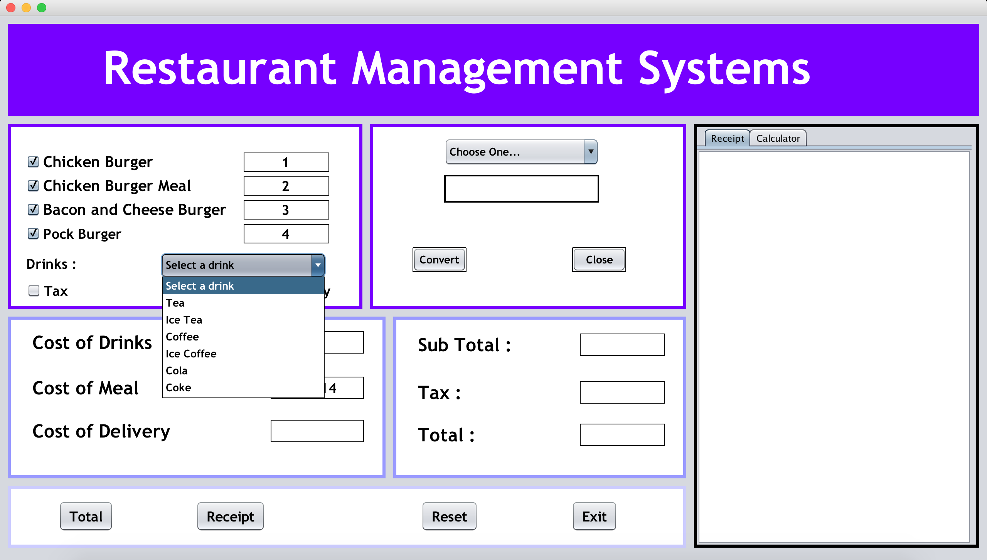
View - Cost of Drinks

Slide 12
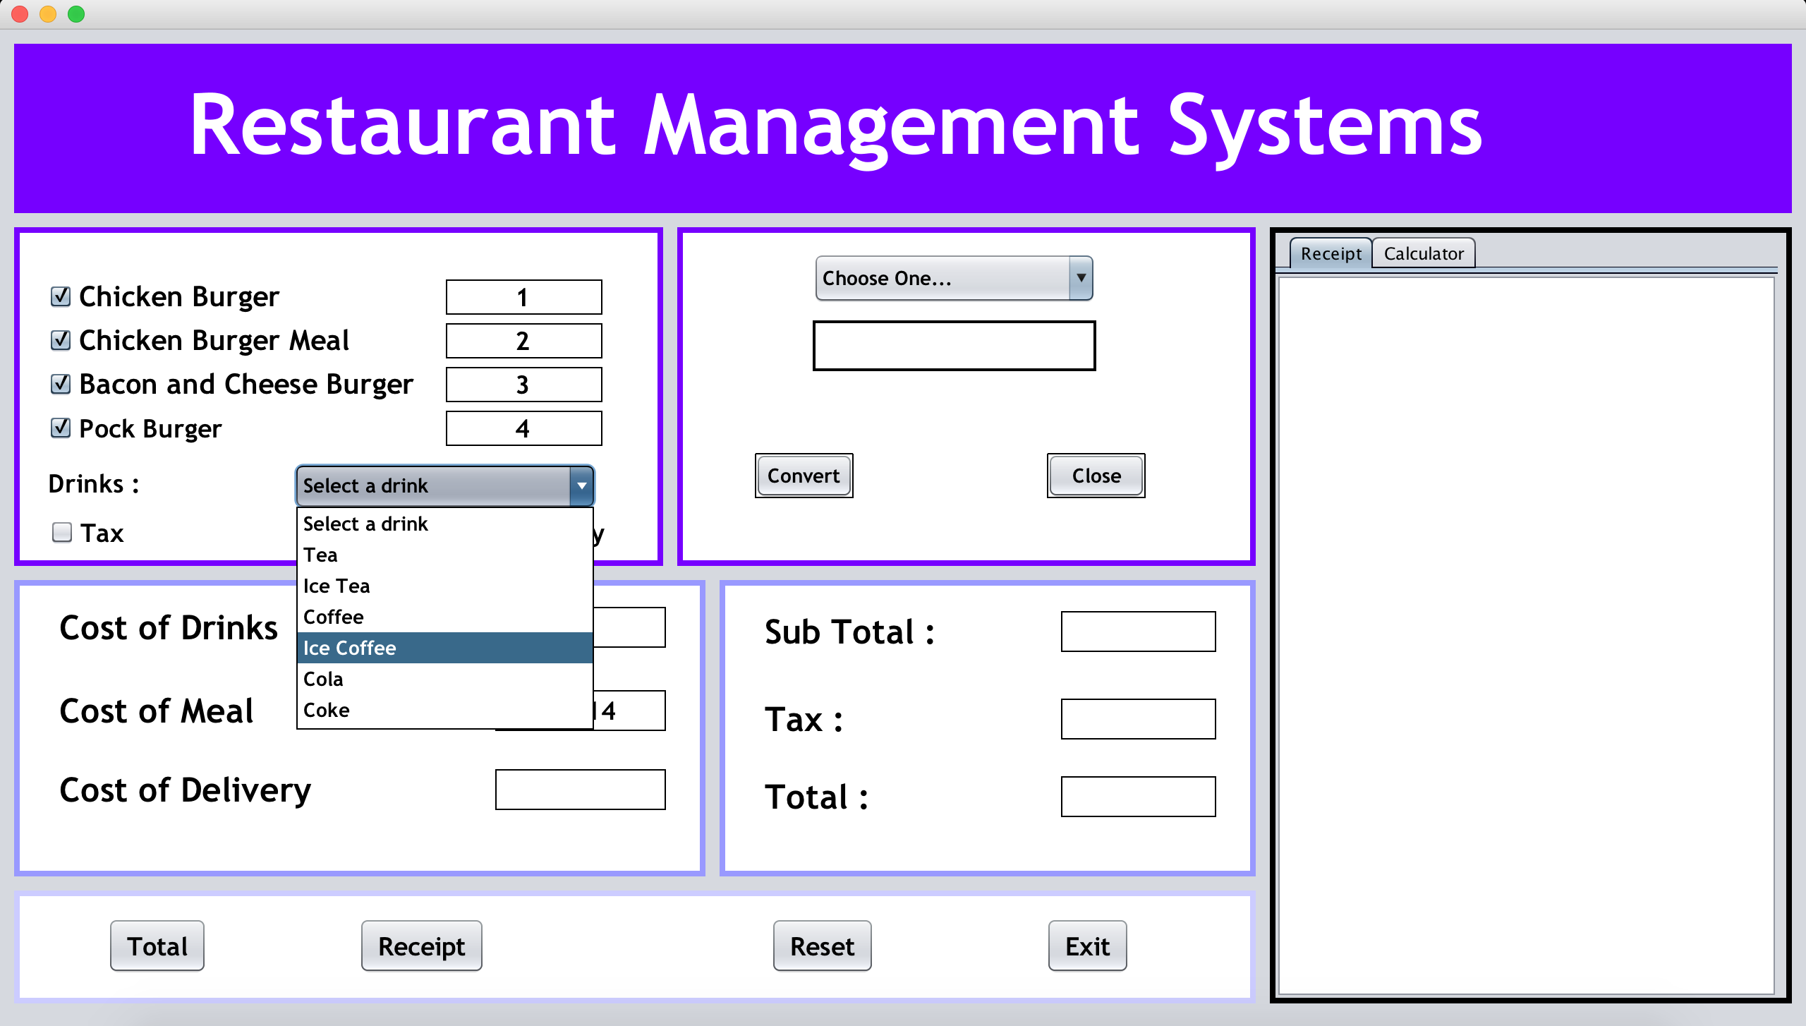
View - Cost of Drinks

Slide 13

View - Cost of Drinks

Slide 14

View - Cost of Delivery

Slide 15
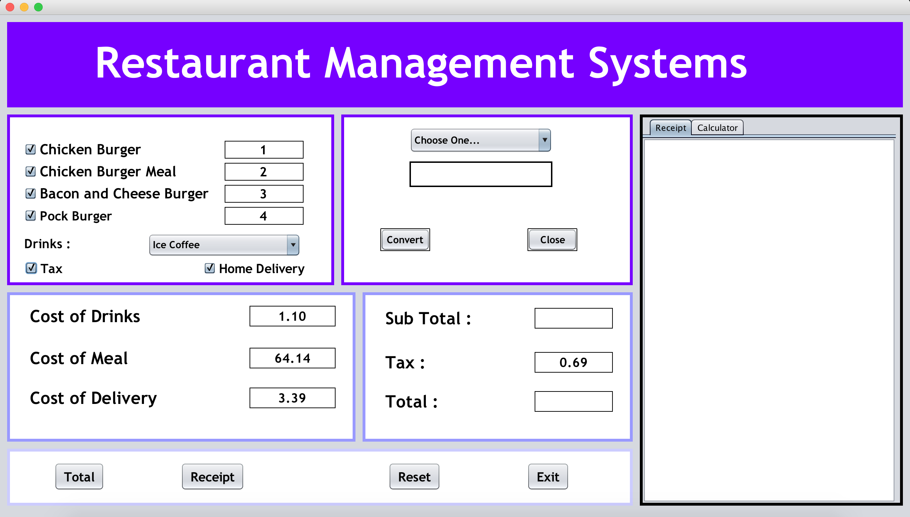
View - Tax

Slide 16
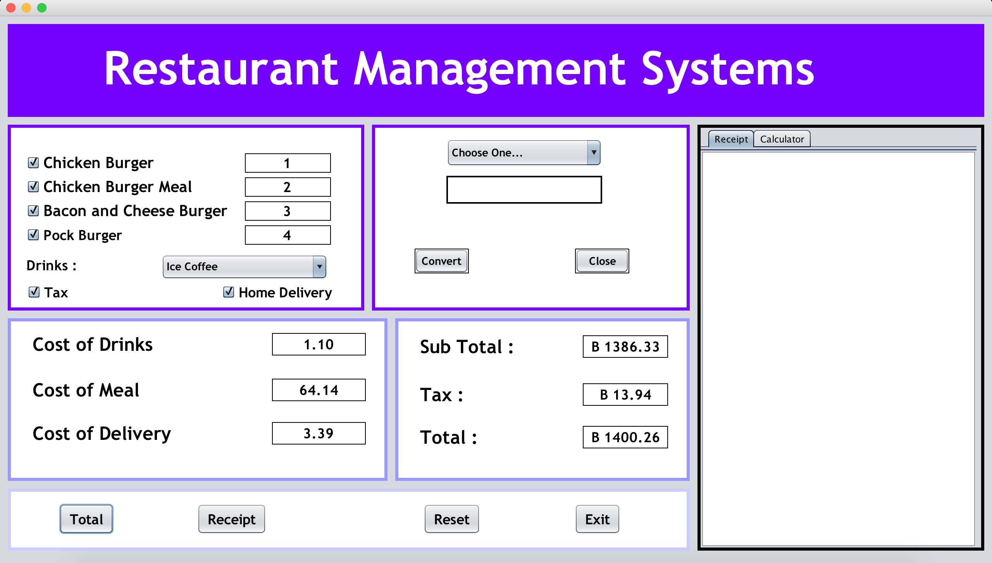
View - Cost of Drinks
+
Sub Total + Tax = Total
________
=
========

Slide 17
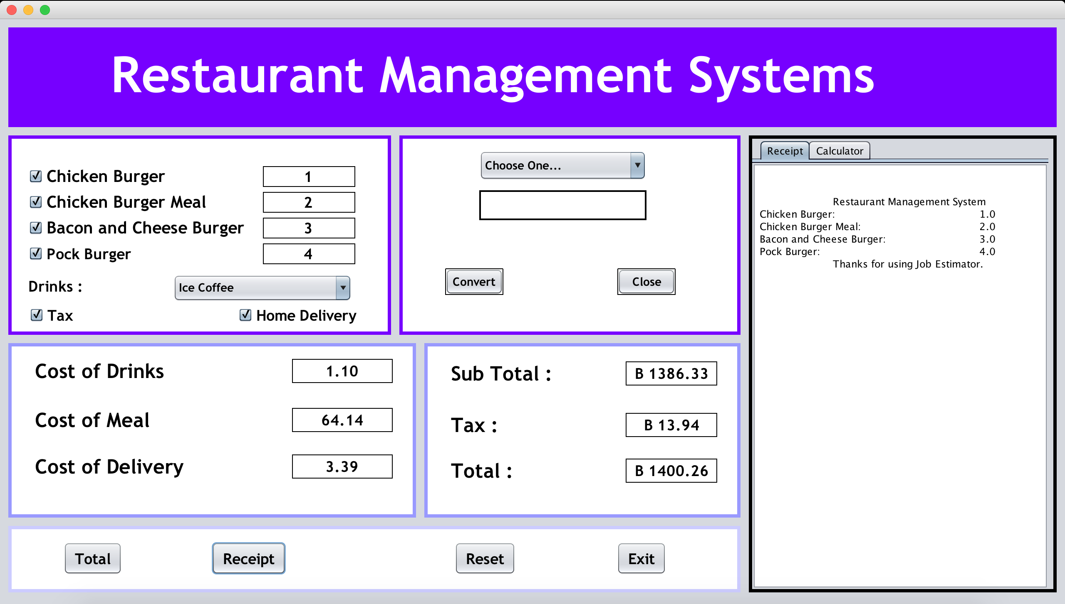
View - Receipt

Slide 18
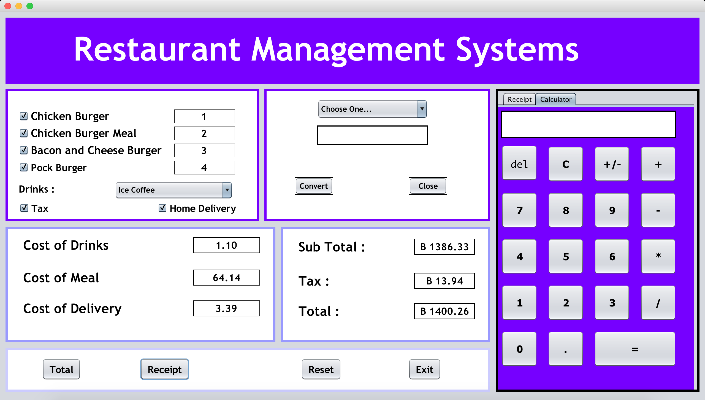
View - Calculator

Slide 19
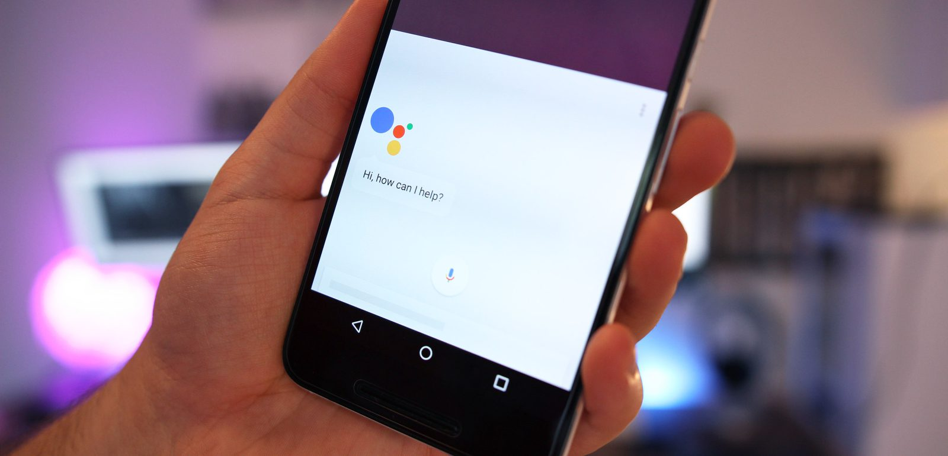
View

Slide 20
Thank You
Thank You

